Slide 1
6. Trouble Shooting Guide
-53-

Slide 2
6.Trouble Shooting Guide
6.1.1 How to Download a Service Manual
You can find trouble shooting guide in General Service Manual on the web
1. Go to Inventory > Parts Portal
2. Search the model name.
3. Go to ‘Technical Pack’ and select ‘Service Manual’.
4. From there, General Service Manual can be downloaded to your computer.
①
②
③
Breakthrough Innovation
-54-
HVAC & Energy Solution

Slide 3
6.Trouble Shooting Guide
6.1.2 Introduction to Basic Mode Controls
■ Cooling Mode
Operating frequency of compressor depends on the load condition, like the difference between the room
temperature and the set temperature, frequency restrictions.
If the compressor operates at some frequency, the operating frequency of compressor cannot be changed
within 90 seconds(except in emergency conditions).
Compressor turned off when;
- Intake air temperature reaches below 0.5°C(1°F) of the setting temperature for 3 minutes continuously.
- Intake air temperature reaches below 1.5°C(3°F) of the setting temperature
Compressors 3 minutes time delay.
- After compressor off, the compressor can restart minimum 3 minute later.
■ Heating Mode
3
Operating frequency of compressor depends on the load condition, like the difference between the room
temperature and the set temperature, frequency restrictions.
If the compressor operates at some frequency, the operating frequency of compressor cannot be changed
within 30 seconds.
Condition of Compressor turned off when;
- Intake air temperature reaches +3℃ above the setting temperature.
Condition of Compressor turned on when;
- Intake air temperature reaches +2℃above the setting temperature.
While in defrost control, the indoor and outdoor fans are turned off.
Breakthrough Innovation
-55-
HVAC & Energy Solution

Slide 4
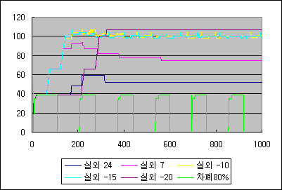
2. Basic Operating System
2.5 Compressor Frequency Restriction
-One of the many frequency restrictions is outdoor temperature limit.Since every model has its own characteristics, Hz varied according to each models.Take Libero R(AS-W126B1U0) for example;
Outdoor Temp (℃) | Cooling (Max Hz) | Outdoor Temp (℃) | Heating (Max Hz)
Outdoor ≤ 0 | 39 | Outdoor ≤ -7 | 107
0< Outdoor ≤10 | 39 | -7< Outdoor ≤-2 | 104
10< Outdoor ≤ 23 | 43 | -2< Outdoor ≤ 4 | 100
23< Outdoor ≤ 30 | 78 | 4< Outdoor ≤ 10 | 97
30< Outdoor ≤40 | 82 | 10< Outdoor ≤21 | 87
46< Outdoor ≤10 | 75 | 21< Outdoor ≤27 | 59
46< Outdoor | 66 | 27< Outdoor | 48
2.6 Comp Operating Hz / Variation of Outdoor Temperature
(Max Hz:107, Min Hz:39)
Outdoor
Outdoor
Outdoor
Outdoor
Outdoor
High
Pressure
1. Max Hz reach time(Heating/Standard Condition) : 330secs
2. High Pressure Condition : 39Hz
3. Preheating Mode(39Hz) Reach time(Low Ambient) : / Around 420secs
Breakthrough Innovation
-56-
HVAC & Energy Solution

Slide 5
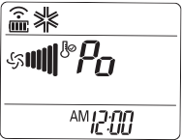
6.Trouble Shooting Guide
■ Healthy dehumidification operation
When the dehumidification operation is set by the remote controller, the intake air temperature is
detected and the setting temp. is automatically set according to the intake air temperature.
Intake air Temp. | Setting Temp.
26°C(78.8°F) ≤ intake air temp. | 25°C(77°F)
24°C(75.2°F) ≤ intake air temp.< 26°C(78.8°F) | intake air temp. -1°C(-2°F)
22°C(71.6°F) ≤ intake air temp. < 24°C(75.2°F) | intake air temp. -0.5°C(-1°F)
18°C(64.4°F) ≤ intake air temp. < 22°C(71.6°F) | intake air temp.
intake air temp. < 18°C(64.4°F) | 18°C(64.4°F)
When intake air temp. is 1°C (2°F) above the setting temp., condition of compressor is same as
in cooling mode operation.
When intake air temperature reaches 1°C(2°F) below the setting temp., compressor operates in
step1~step3 and the indoor fan speed again operates at low speed or comes to a stop.
■ Cooling Intelligent Mode
At the beginning of Fuzzy mode operation, the setting temperature is automatically selected
according to the intake air temp at that time.
When the Fuzzy key (Temperature Control key) is input, the initial setting temperature is selected,
the Fuzzy key value and the intake air temperature at that time are compared to select the setting
temperature automatically according to the Fuzzy rule.
While in Fuzzy operation, the airflow speed of the indoor fan is automatically selected according
to the temperature.
■ Hot start
The indoor fan stops until the evaporator piping temp. reaches 29℃ (optional).
During heating operation, if piping temp. falls below 26℃(optional) the indoor fan will stop.
■ Jet Cool/Heat
This mode allows you to cool indoor air quickly in summer or warm it quickly
in winter.
- In jet cooling mode, strong air blows out at a temp. of 18°C for 30 minutes.
- In jet heating mode, strong air blows out at a temp. of 30°C for 30 minutes.
Breakthrough Innovation
-57-
HVAC & Energy Solution

Slide 6
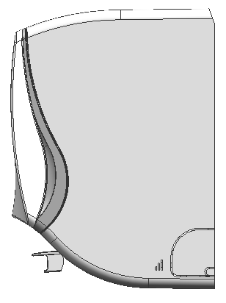
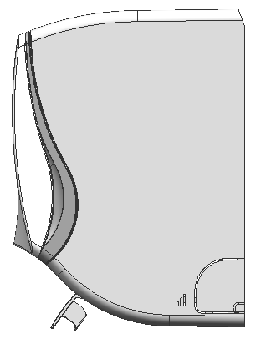
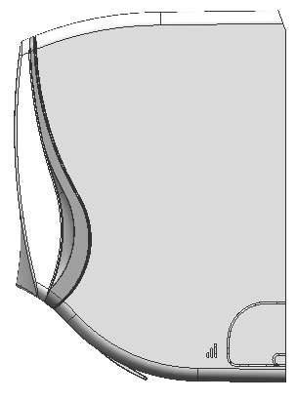
6.Trouble Shooting Guide
■ Auto Restart
-This function is useful in the situation of power failure.
When power regains after a failure this feature restore the previous
operating condition and the air conditioner will run in the same settings
This function is enabled by factory default setting. But you can disable
it by pressing the ON/OFF button for 6 seconds.
-The unit will beep twice and the lamp will blink 6 times. To enable it,
press the button again for 6 seconds. The unit will beep twice and
the blue lamp will blink 4 times.
ON/OFF
Button
■ Eva Frosting Prevention
- Comp and Outdoor fan stop when indoor evaporator pipe temperature is below 0℃ and restart
when the pipe temperature is above 7℃.
■ Compressor 2or 3 minutes Delay
- In the case when the compressor restarts after compressor off, there is time delay of 3-min. in order
to prevent damage to compressor due to frequent ON/OFF .
■ Indoor Fan Start 5 seconds Delay
- Once OFF, the indoor unit fan will start with a delay of 5 seconds in order to prevent noise which
may be caused if the vane opening time and the fan start time are the same.
■ Function Activation Delay Time
- Loads such as Fan speed control , Compressor, Timer etc are activated 2~ 3 seconds after
the corresponding key is pressed on the Remote controller .
■ Different angle of vane for each operation mode
Mode
Cooling/Fan Mode
Dehumidification
Heating
Sleep Mode/AutoClean
R.Control
Display
/
Breakthrough Innovation
-58-
HVAC & Energy Solution

Slide 7
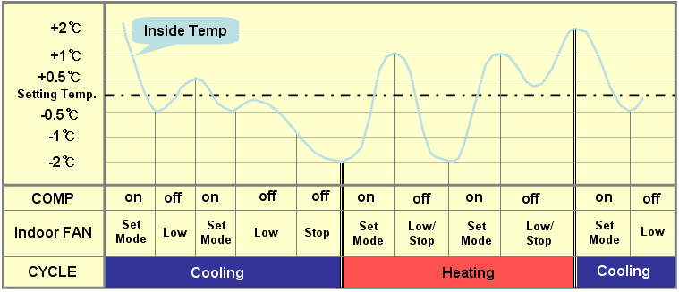
6.Trouble Shooting Guide
■ Auto Changeover
- With heat pump model, cooling and heating operation is changed automatically on the basis of the
room temp.
Initial Setting Temp: 22℃ (Memorize the final setting temp)
Control of setting temp.
- Wireless Remote Controller: 18-30 ℃.
- Reset Button in indoor unit: memorized final temp.
- Variation : -2 to + 2 ℃
Breakthrough Innovation
-59-
HVAC & Energy Solution

Slide 8
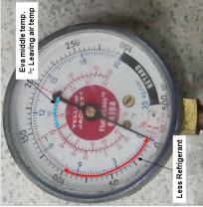
Check the output voltage of power transistor
NORMAL
Insufficient refrigerant
Check installation condition
Inefficient compressor
Clogged EEV or capillary tube
Check for the displayed error code.
Indoor Error: refer page 68
Outdoor Error: refer page 70
Refer <Trouble 3> page 64 for further instruction
Make sure the required spaces
for installation[Refer page:25]
Possibility of malfunction
Compressor/fan motor[Page 73,74]
Make sure that the installation
process is properly done
[Refer page: 43]
EEV:Electronic Expansion Valve
More than
8℃(cooling)
or 14 ℃(heating)
Low
Low
Low
YES
NO
YES
Is there any Error
Code being displayed?
Does Compressor/Outdoor Fan operate?
Is there a large operating noise & vibration
Check the difference in the intake and outlet air temperature
Check the gas side pressure
Unit ON
NO
YES
NO
Less than 8℃ (cooling)
Or 14℃ (heating)
Refer page 46 on how to read
a pressure manifold
Turn On the Unit
(by Remote Controller)
-60-
Refer to <Trouble 1> Unit doesn’t operate at all(Page 63)
Is there any Error
Code being displayed?
Check the power supply.Is there a power failure?
Has a breaker been turned off or a fuse blown?
Possibility of damaged Outdoor Unit PCB.
Unit OFF
Unit OFF
NO
NO
NO
Open the front grille,try to turn on the unit by ON/OFF switch
YES
YES
YES
ON/OFF
Switch
6.Trouble Shooting Guide
Refer to <Trouble 2>
Unit doesn’t operate according to remote controller (page 63)
Check for the displayed error code.
Indoor Error: refer page 68
Outdoor Error: refer page 70
Make sure that the rated voltage
is supplied.[AC 208~230V, 60Hz ]
Check fuse condition & connection
wires.Make sure there is no electric short
[Refer page 34~36]
Make sure to check PCB condition &
refer to page 75 on how to measure
IPM circuit
6.1.3 Symptoms Overview
Unit ON

Slide 9
6.Trouble Shooting Guide/6.1.3 Symptoms Measures & Diagnosis
Symptoms which are not operational problems
Case | Explanation
Operation does not start immediately - When starting the unit just after it had been stopped. - When the mode(Cooling/Heating) was reselected. | This is to protect the air conditioner Wait for about 3 minutes
Hot air doesn’t come out at the start of heating operation | Air conditioner is warming up. Wait for 1 to 3 minutes (The system is designed to start discharging air only after it has reached a certain temperature)
Haze comes out of the indoor unit | Happens when the air in the room is cooled into mist by the cold airflow during cooling operation
Outdoor unit emits steam or water | Heating Mode -The frost at outdoor unit melts into water or steam when the air conditioner is in defrost operation Cooling Mode - Moisture in the air condenses into water on the cool surface of outdoor unit piping and drops
Re-Check List
Case | Check
The unit doesn’t operate (Display LED is off) | Has a breaker been turned Off or a fuse blown? Is there a power failure? Are fresh batteries installed in the remote controller? Is the timer setting correct?
Poor Cooling/Heating effect | Are the filters clean? → See page 115 on how to clean the filters Is anything blocking the air inlet/outlet of the indoor&outdoor units? Is the temperature setting appropriately? Are the windows and doors closed? Are the airflow and its direction set properly?
Operation suddenly stops (Display LED is on) | Are the filters clean?→ See page 115 on how to clean the filters Is anything blocking the air inlet/outlet of the indoor&outdoor units? Turn the electric breaker off, clean the air filters or remove obstacles.Then turn the breaker on again & try operating the unit with the remote controller.If the lamp still blinks, check for error code in Trouble Shooting section.
Breakthrough Innovation
-61-
HVAC & Energy Solution

Slide 10
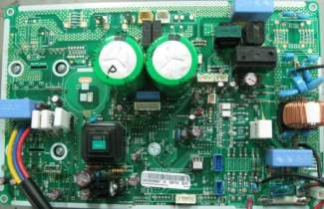
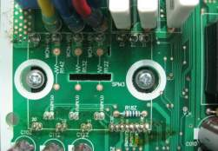
6.Trouble Shooting Guide
6.1.4 – Symptoms Measures & Diagnosis-Air Conditioner System (Electronic Parts)
<Trouble 1>
Unit doesn't operate at all.
Turn off the main power and wait until LED on outdoor PCB is off.
Turn on main power again.
Does “Beeping” sound is made from the indoor unit?
Does “Lighting” LED is mounted on the outdoor PCB?
NO
YES
Check the voltage of power (AC 208~230V, 60Hz)
Primarily, the operating
condition of Micom is O.K
The voltage of main power.
The voltage applied to the unit.
The connecting method of Indoor/Outdoor
connecting cable (each color)
Outdoor PCB Assembly
(Fuse, Noise Filter, Power Module (SMPS), IC01D, IC04D)
Check Indoor PCB CN-DISP1
The operation check of the PCB Assembly
Procedure
Specification
Remedy
1) The input voltage of Power
Module (SMPS)
2) The output voltage of Power
Module( SMPS)
3) IC01D(LD1085), IC04D(7805)
: DC 220V~390V
: 15V ±10%
: DC 5V
Replace the P.C.B
2KW Controller
P
W
V
U
Nu
Nv
Nw
27
26
25
24
23
22
21
P
W
V
U
N
w
N
v
N
u
SPM3
Check for short
[ IPM Pin Arrangement and
Pin Numbers]
Breakthrough Innovation
-62-
HVAC & Energy Solution

Slide 11
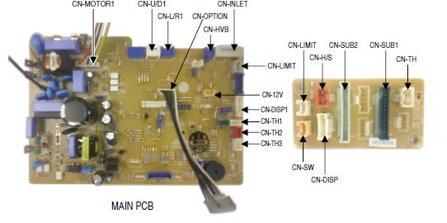
6.Trouble Shooting Guide
<Trouble 2>
Unit doesn't operate according to the remote controller
Turn on main power
While the compressor has been stopped, the compressor does not operate
owing to the delaying function for 3minutes after stopped.
When the compressor stopped Indoor fan is driven by a low speed.
At this point the fan speed is not controlled by the remote controller.
(When operated in the Sleeping Mode, the wind speed is set to the low speed as force)
Caused by the remote controller.
Caused by other parts
When the mark( ) is displayed in LCD
Screen, replace battery.
Check the contact of CN-DISP 1,2 connector
(Refer below PCB picture)
Check DISP PCB Assembly
- voltage between CN-DISP ③-⑧ : DC+5V
Check Point
Check the connecting circuit between
MICOM PIN 27 and CN-DISP1 PIN⑦
Check receiver Assembly
CN-DISP 2
Main PCB
Disp PCB
Breakthrough Innovation
-63-
HVAC & Energy Solution

Slide 12
6.Trouble Shooting Guide
<Trouble 3>
Compressor/Outdoor Fan doesn't operate
Turn on the Main Power
Operate "Cooling Mode( )" by setting the desired temperature of the remote controller at least 1.5℃ higher than the indoor side temperature
Compressor/Outdoor Fan is stopped during Air Circulation Mode
Check the sensor for indoor temp sensor whether it is attached as close as to be effected by the temperature of Heat Exchanger(HEX) or not
When Error Code is displayed, refer to the error code table in t/shooting guide section
Check the main power source. (AC 208V~230V)
Check the t/ shooting guide error code 21,26
Check that CN_FAN supplied voltage to outdoor PCB is about AC208V~230V
Turn off Main Power
Check the electrical wiring diagram of outdoor side
Check the connection wires between indoor and outdoor
Breakthrough Innovation
-64-
HVAC & Energy Solution

Slide 13
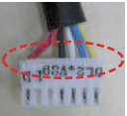
6.Trouble Shooting Guide
<Trouble 4>
Indoor Fan does not operate
Turn off the main power
Check the connection of CN-FAN
Check the Fan Motor
Check the Fuse(AC250V, T2A)
Check the circuit of indoor Fan Motor.
The pin NO. 38 of micron and the part for driving SSR(Solid State Relay). (Q01M)
Check the related pattern.
Check the SSR.
- SSR Open : Indoor Fan Motor will not operate.
- SSR short : Indoor Fan Motor operates in case of ON or OFF
Turn on the main power
Check the SSR high speed operation by remote
control (Indoor Fan Motor is connected).
The voltage of Pin No1(orange) and 3(balck)
of CN-FAN
Approximately 160V over
Approximately 50V over
SSR is not damaged
Check SSR
Breakthrough Innovation
-65-
HVAC & Energy Solution

Slide 14
6.Trouble Shooting Guide
<Trouble 5>
Vertical Louver does not operate
• Verify that the Vertical Louver is geared with the shaft of stepping motor.
• If the regular torque is detected when rotating the Vertical Louver with hands → Normal
• Check the connecting condition of CN-U/D Connector
• Check the soldering condition(on PWB) of CN-U/D Connector
Check the operating circuit of Vertical Louver at Indoor PCB
• Confirm that there is DC +12V between pin ① (RED) of CN-U/D and GND.
• Confirm that there is a soldering short at following terminals.
- Between 60,61,62 and 63 of MICOM
- Between 2,3,4 and 5 of IC01M
- Between 15,14,13 and 12of IC01M
If there is no problems after above checks
• Check the assembly conditions and make sure that there are no interfering parts
in the rotation radial of the Vertical Louver
Breakthrough Innovation
-66-
HVAC & Energy Solution

Slide 15
6.Trouble Shooting Guide
<Trouble 6> Heating Mode is not operating
Operate “Heating Mode ( )” by setting the desired temperature of the remote controller higher than one of the indoor temperature by 3°C at least.
Turn On the Main Power
Check the connector of intake and pipe sensor
In heating mode, the indoor fan will only operate when the pipe temperature is higher than 28°C.
• Check the related circuit of RY-4WAY
• Check the indoor room sensor whether it is disconnected or not.
• Check the indoor pipe sensor whether its disconnected or not.
Check the DC voltage on the PCB ASSEMBLY
• Comp Relay.
• Outdoor fan Relay
Check point
Comp ON
Comp OFF
Check point
Fan ON
Fan OFF
Between Micom
(NO.59) and GND
DC 5V
DC 0V
Between Micom
(NO.53) and GND
DC 5V
DC 0V
Between IC01M
(NO.11) and GND
Below
DC 1V
About
DC 12V
Between IC02M
(NO.12) and GND
Below
DC 1V
About
DC 12V
• 4 way Relay
Check point
4 way ON
4 way OFF
Between Micom(NO.51) and GND
DC 5V
DC 0V
Between IC02M(NO.11) and GND
Below DC 1V
About DC 12V
Turn Off the Main Power
• Check the electrical wiring diagram of outdoor unit.
• Check if there is any abnormal condition concerning Compressor / Outdoor Fan Motor, 4 way.
• Check the connection wires between indoor and outdoor unit.
Breakthrough Innovation
-67-
HVAC & Energy Solution

Slide 16
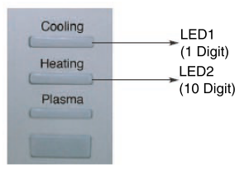
6.Trouble Shooting Guide
6.1.5 Error Code & Descriptions
■ Error Indicator
• The function is to self-diagnosis air-conditioner and express the troubles identically if there is
any trouble.
• If more than two troubles occur simultaneously, primarily the highest trouble of error code is expressed.
• After error occurrence, if error is released, error LED is also released simultaneously.
• To operate again on the occurrence of error code, be sure to turn off the power and then turn on.
• Having or not of error code is different from Model.
■ Indoor unit error – Descriptions
Error code | Description | Error indication
 |  | Indoor unit
 |  | LED1 | LED2
1 | Indoor Sensor (Air) open/short | 1 Time | -
2 | Indoor Sensor (Entry Pipe) open/short | 2 Times | -
5 | Communication Failure (Indoor Unit ↔ Outdoor Unit) | 5 Times | -
6 | Indoor Sensor (Exit Pipe) open/short | 6 Times | -
9 | EEPROM ERROR (Indoor Unit) | 9 Times | -
10 | Indoor Unit Fan Lock (Operation Failure) | - | 1 Time
12 | Indoor Sensor (Middle Pipe) open/short | 2 Times | 1 Time
1) SB,SC chassis
2 )SH chassis
3) SE,S8,SD
SE
1 Digit
10 Digit
Breakthrough Innovation
-68-
HVAC & Energy Solution

Slide 17
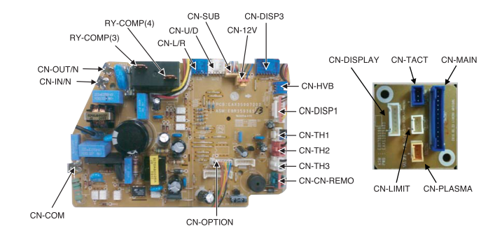
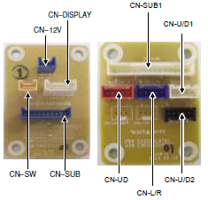
6.Trouble Shooting Guide
6.1.6 Indoor unit
SB Chassis Indoor PCB(Printed Circuit Board)
-Picture: SB Libero R [Model Name:ASNH 09/12GB1U0]
[Main PCB]
[Sub A PCB]
SC Chassis Indoor PCB(Printed Circuit Board)
-Picture: SC Libero R [Model Name:ASNH 18/24 GC2U0]
[Main PCB]
[Sub A / Sub B PCB]
※For more details, refer to each model’s wiring diagram in Service Manual
Breakthrough Innovation
-69-
HVAC & Energy Solution

Slide 18
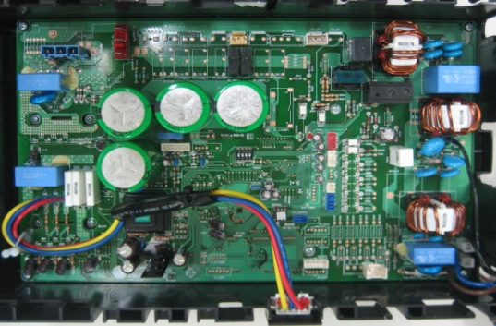
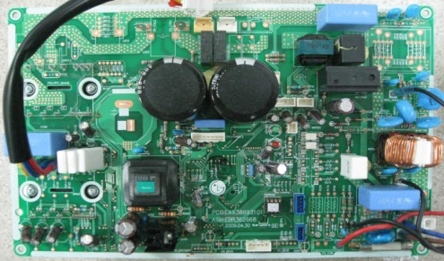
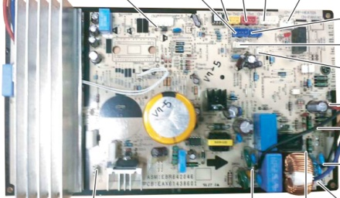
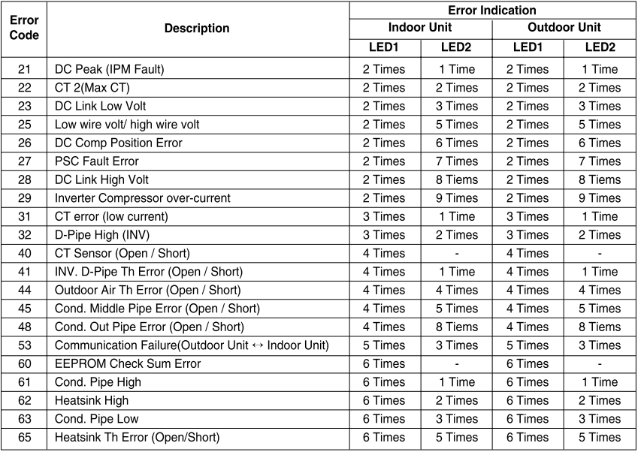
6.Trouble Shooting Guide
■ Outdoor unit error – LED Location
4kw Controller(UE,UE1)
2kw Controller(UL,UL2)
1.5kw Controller(UA3)
2 LED Type
2 LED Type
1 LED Type
1) 2 LED Type
2) 1 LED Type
LED1
Green,1 Digit
LED2
Red, 10 Digit
Ex) Error Code 21 (DC Peak)
■ Error Descriptions
1Sec
2Secs
1Sec
2Secs
1Sec
2Secs
1Sec
2Secs
Red
Green
Breakthrough Innovation
-70-
HVAC & Energy Solution

Slide 19
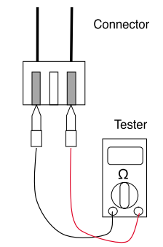
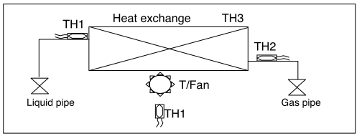
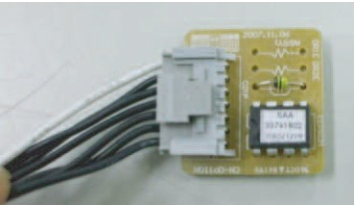
6.Trouble Shooting Guide
6.1.6 Trouble Shooting / Error Code (Indoor Unit)
Error Code CH01, CH02, CH06,CH12
Error code | Title | Cause of error | Check Point
01 | Indoor air sensor | Poor Connection Open / Short | Check sensor connection status Normal resistor : 10㏀ /at 25℃(77℉)
02 | Indoor inlet pipe sensor | Poor Connection Open / Short | Check sensor connection status Normal resistor : 5㏀ /at 25℃(77℉)
06 | Indoor outlet pipe sensor | Poor Connection Open / Short | Check sensor connection status Normal resistor : 5㏀ /at 25℃(77℉)
12 | Indoor middle pipe sensor | Poor Connection Open / Short | Check sensor connection status Normal resistor : 5㏀ /at 25℃(77℉)
1.Check if the temperature connection part is securely connected.
2.After disconnecting from temperature sensor PCB assembly, measure each sensor’s resistance
3.If the measurement indicates infinite or 0Ω please replace temperature sensor.
4.If the measurement is normal. then please check main indoor PCB and replace
Inlet pipe sensor
Middle pipe sensor
Outlet pipe sensor
Air sensor
Error Code CH09
Error code | Title | Cause of error | Check Point
09 | Option PCB error | Poor connection of option PCB | Check the connection status of the option PCB
1. Check the option PCB is properly connected
Breakthrough Innovation
-71-
HVAC & Energy Solution

Slide 20
6.Trouble Shooting Guide
Error Code CH05, CH53
Error code | Title | Cause of error | Check Point
05 / 53 | Communication (Indoor → Outdoor) | The communication between indoor<-> outdoor unit is stopped for more than 3 minutes | Power input AC 208~230V.(Outdoor, Indoor) The connector for transmission is disconnected The connecting wires are misconnected. The GND 1,2 is not connected at main GND. The communication line is shorted at GND. Transmission circuit of outdoor PCB is abnormal. Transmission circuit of indoor PCB is abnormal.
*CH05 is displayed at indoor unit, CH53 is displayed at outdoor unit
1. Check the input power AC 208~230V.(Outdoor, Indoor)
2. Check the communication wires are correctly connected.
→ Adjust the connection of wire
→ Confirm the wire of “Live”, “ Neutral”
3. Check the resistance between communication line and GND. (Normal : Over 2㏁)
4. Check the connector for communication is correctly connected.
5. Check the connection of GND, GND2, and main GND.
Breakthrough Innovation
-72-
HVAC & Energy Solution

