Slide 1
How to check Wireless Remote Controller
Technical Tip
GCS RHQ, MENA
June , 2012
Notes:
(#/#)

Slide 2
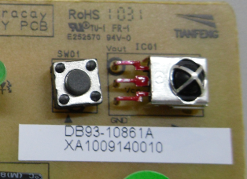
Issue Details & Solution
Symptom:
Remote is not working
Causes:
Defective Module
Defective PBA
Defective remote controller
Solution:
Check if IDU is working or not
Check if remote controller or Indoor unit is malfunction
by using Forced operation KEY
※ If it’s not working by Forced operation key, indoor unit is
defective.
Force operation
key

Slide 3
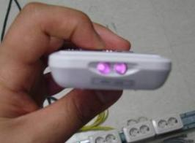
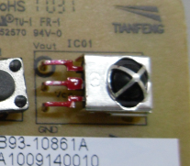
Issue Details & Solution
Solution:
Check if remote is working or not
When you check remote by using camera or some lens, Remote
output the violet signal (if remote is normal)
Check Module(VCC)
Check receiver module. Check VCC(DC 5V)
※ If DC 5V is not applied, Main PBA and Panel PBA
are defective.
Check method for normal module(VOUT)
If Module VCC is normal, Check VOUT operation.
When input remote controller signal, less than DC
voltage variable operation, those are good.
Vout
Vcc
GND

Slide 4
Thank you
GCS
Technical support – CE P.
System Air conditioning
Malek A. Al Nimer
Malek.n@samsung.com

