Slide 1
Option Code
CAC
(2011. August)
GCS HQ

Slide 2
Option Code
Option Code is the information which controls indoor unit state [ control the features, like increase or decrease the indoor fan RPM).
Option code used to be entered when it lost from the memory to establish proper function of A/C or when we replace the PBA control board.
Option code can be obtained from the service manual or installation manual which is already attached with the unit itself or you can get the service manual from GSPN.
http://gspn1.samsungcsportal.com

Slide 3
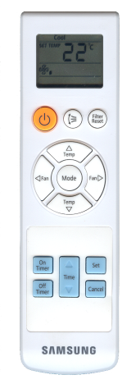
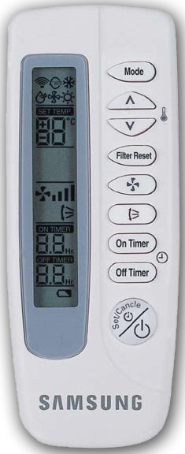
Option Code
To set the option code:
Wireless remote controller in case of [ Wall Mounted Air Conditioner, Cassette type Air conditioner etc.).
MR-AH01
MR-CH01

Slide 4
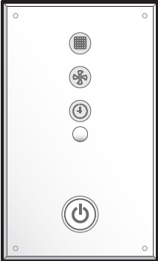
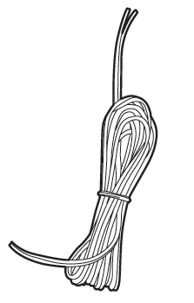
Option Code
Wireless signal Receiver Kit. In addition to wireless remote controller in case of slim duct, MSP [ Medium Static Pressure ] duct A/C.
MRK-A00 [ Receiver Kit ]
MRW-10A [ Receiver Wire ]
Note: Receiver Kit is only available for ducted indoor unit

Slide 5
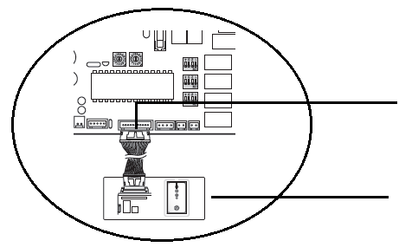
Option Code
How to connect signal receiver kit ?
Indoor Control PBA
CN 91
MRK-A00 [ Receiver Kit ]
Wireless Remote Controller

Slide 6
Option Code
How to connect signal receiver kit ?
Connect one end of the receiver wire (MRW-10A) with the receiver kit (MRK-A00).
Connect the other end of the receiver wire (MRW-10A) with the ducted indoor unit PCB (CN91)

Slide 7
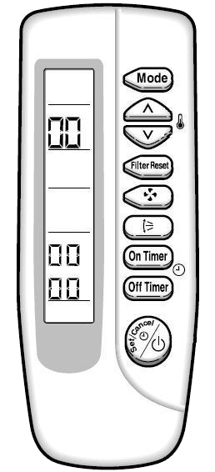
Option Code
Option code setting mode (MR-AH01), How to enter Option Code !!
Remove one battery from the wireless remote controller
Press together and put the battery back to enter the option code setting mode
Use the Mode button to toggle the option code page
Press the Set/Cancel button to change the option code

Slide 8
Option Code
Example: [ Insert Option code for Wall mounted A/C : 65 80 37 02 38 ]

Slide 9
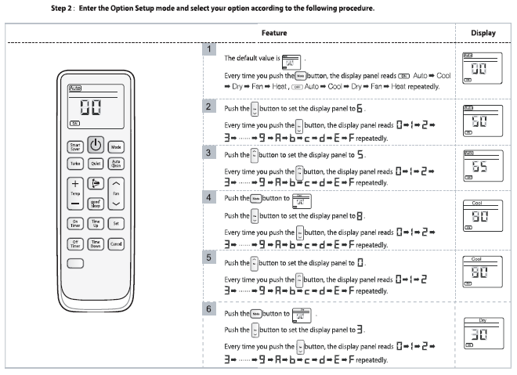
Option Code

Slide 10
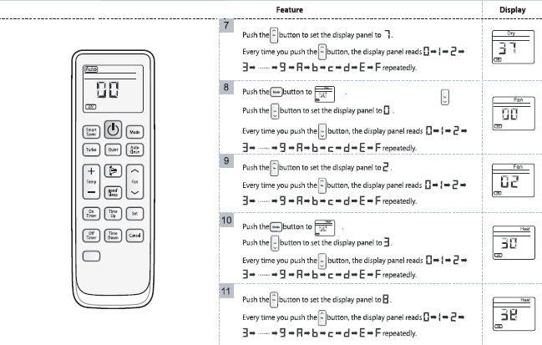
Option Code

Slide 11
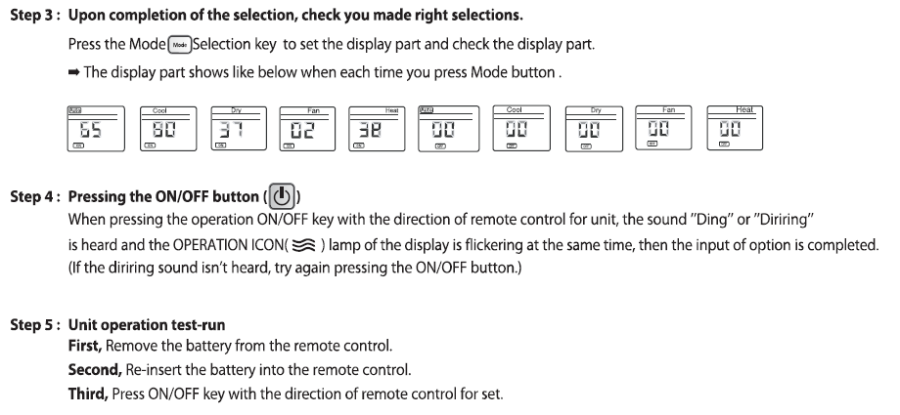
Option Code

Slide 12
Thank You

